Slide 1

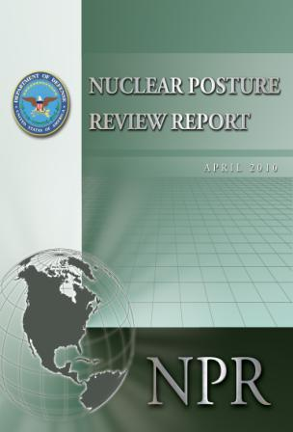
Nuclear Posture Review
Background Briefing for Media
April 5, 2010

Slide 2
The President’s Nuclear Security Agenda
First articulated in Prague in April 2009
  Reduce nuclear dangers and pursue the long-term goal of a world without nuclear weapons
  Sustain a safe, secure, and effective nuclear arsenal as long as nuclear weapons exist
Key events in the President’s nuclear security agenda
  Nuclear Posture Review
  New START Treaty
  Nuclear Security Summit
  NPT Review Conference

Slide 3
Congressional Direction
DoD-led review in consultation with Departments of State and Energy
Review nuclear posture for the next 5 to 10 years
Serves as basis for establishing U.S. arms control objectives
7 elements of the review:
  Role of nuclear forces in U.S. military strategy, planning, and programming;
  Objectives for U.S. to maintain a safe, reliable, and credible nuclear deterrence posture;
  Relationship among U.S. nuclear deterrence policy, targeting strategy, and arms control objectives;
  Role missile defenses & conventional strike play in determining roles and size of nuclear forces;
  Levels and composition of the nuclear delivery systems;
  Nuclear weapons complex we require, including plans to modernize or modify the complex;
  The nuclear stockpile that will be required for implementing U.S. strategy.

Slide 4
NPR Scope, Conduct, and Product
Scope:
  President’s nuclear agenda
Conduct:
  Interagency
  Consultative
  Senior Leader engagement
Product:
  Unclassified report to Congress

Slide 5
Key Objectives
  Prevent nuclear proliferation and nuclear terrorism
  Reduce the role of nuclear weapons
  Maintain effective strategic deterrence and stability at lower nuclear force levels
  Strengthen regional deterrence and reassurance of U.S. allies and partners
  Sustain a safe, secure and effective nuclear arsenal as long as nuclear weapons remain

Slide 6
The NPR and the New Strategic Arms Reduction Treaty
Early priority to analytically derive negotiating positions for the New START negotiations.
  Considered a range of solutions to maintain strategic stability while reducing operationally deployed strategic nuclear force levels.
The NPR determined that the United States should maintain a nuclear Triad of ICBMs, SSBNs, and heavy bombers.
New START:
  1,550 accountable warheads
  Combined limit of 800 deployed and non-deployed ICBM launchers,
  SLBM launchers, and nuclear-capable heavy bombers
  Separate limit of 700 deployed ICBMs, deployed SLBMs, and deployed nuclear-capable heavy bombers
  Does not constrain U.S. programs or plans for missile defense or conventional systems.

Slide 7
The NPR and the FY 2011 Budget Request
The United States will sustain a safe, secure, and effective nuclear deterrent as long as nuclear weapons exist.
President’s fiscal year 2011 budget request includes a 13 percent increase for stockpile modernization efforts.
  Supports the W76 and B61 LEPs
  Follow-on study of the W78
  Funds the Chemistry and Metallurgy Research Replacement nuclear facility at Los Alamos National Laboratory
  Builds a new Uranium Processing Facility at Y-12 Plant in Oak Ridge
  Funds science, technology, and engineering
The NPR will outline this Administration guidelines for managing the U.S. nuclear stockpile.

